Slide 1
Project NMS: Design phase
Remy Bien
Sebastiaan Groot
Wouter Miltenburg
Koen Veelenturf

Slide 2
Content
Overview
Introduction
Project definition
Functional design
Scope & MoSCoW
Use-Case
Wireframe
Technical design
Database
Application Architecture
Device Support
Demo
Development phase

Slide 3
introduction

Slide 4
Network Management System
Goal:
Network Management System (NMS) is a network device management web-application, to be released under a free, open-source license with multi-vendor support.
Target Group:
System Administrators.

Slide 5
Functional design

Slide 6
Scope & Moscow
Must
The system must support CISCO devices;
The system must be able to open or shutdown network ports;
The system must make use of a database such as SQlite;
The system must have pluggable support.
Should
The backend should be python based;
The system should have multi-vendor support;
The system could have a nice modern looking interface;
The system should support user authentication.
Could
The system could have ACL (access control list) rules;
The system could have multi database support;
The system could have an auto-detection mechanism (e.g. OS version).
Won’t
The system won’t have multi-language support.

Slide 7
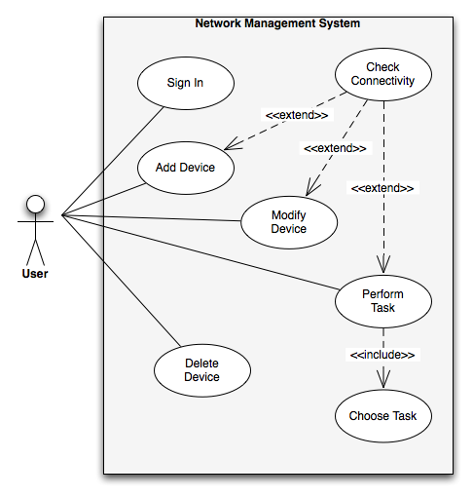
Use case

Slide 8
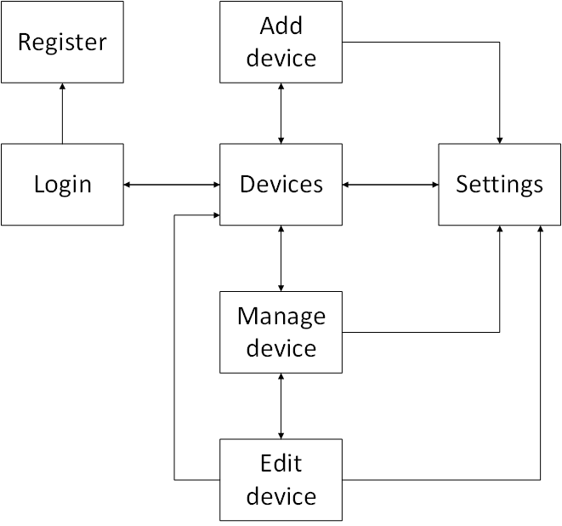
Wireframes

Slide 9
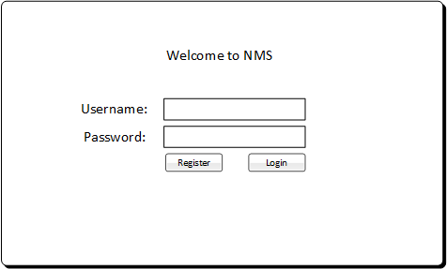
Wireframes: Login

Slide 10
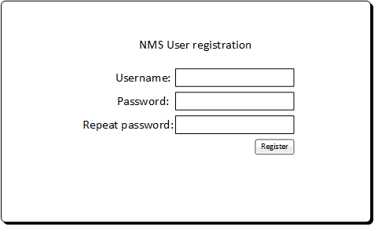
Wireframes: Register

Slide 11
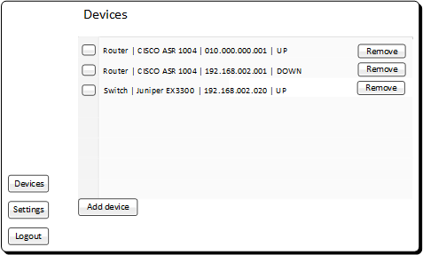
Wireframes: Devices

Slide 12
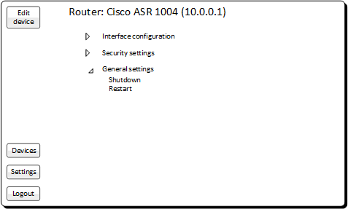
Wireframes: Manage Device

Slide 13
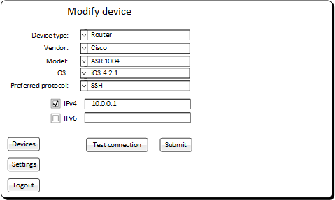
Wireframes: Modify Device

Slide 14
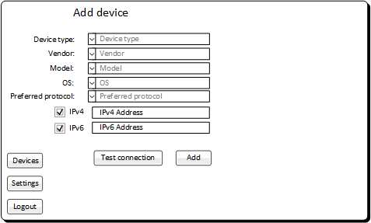
Wireframes: Add Device

Slide 15
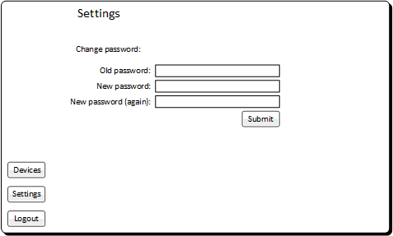
Wireframes: Settings

Slide 16
Demands
Demands
The delivered product must be made available under an Open Source license
Documentation must be available and be usable for System Engineers
The delivered product must be modular and expandable
The product must support devices from multiple vendors
The product must support different OS versions of a device

Slide 17
Techinical Design

Slide 18
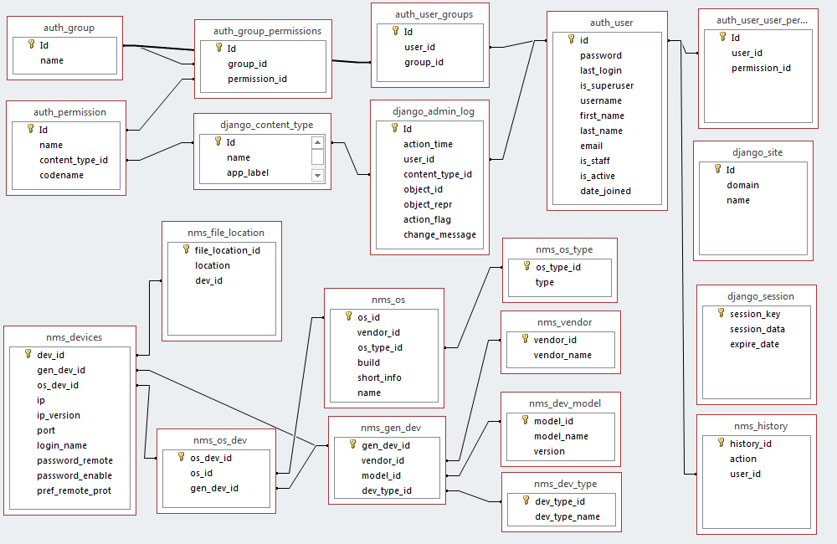
Database

Slide 19
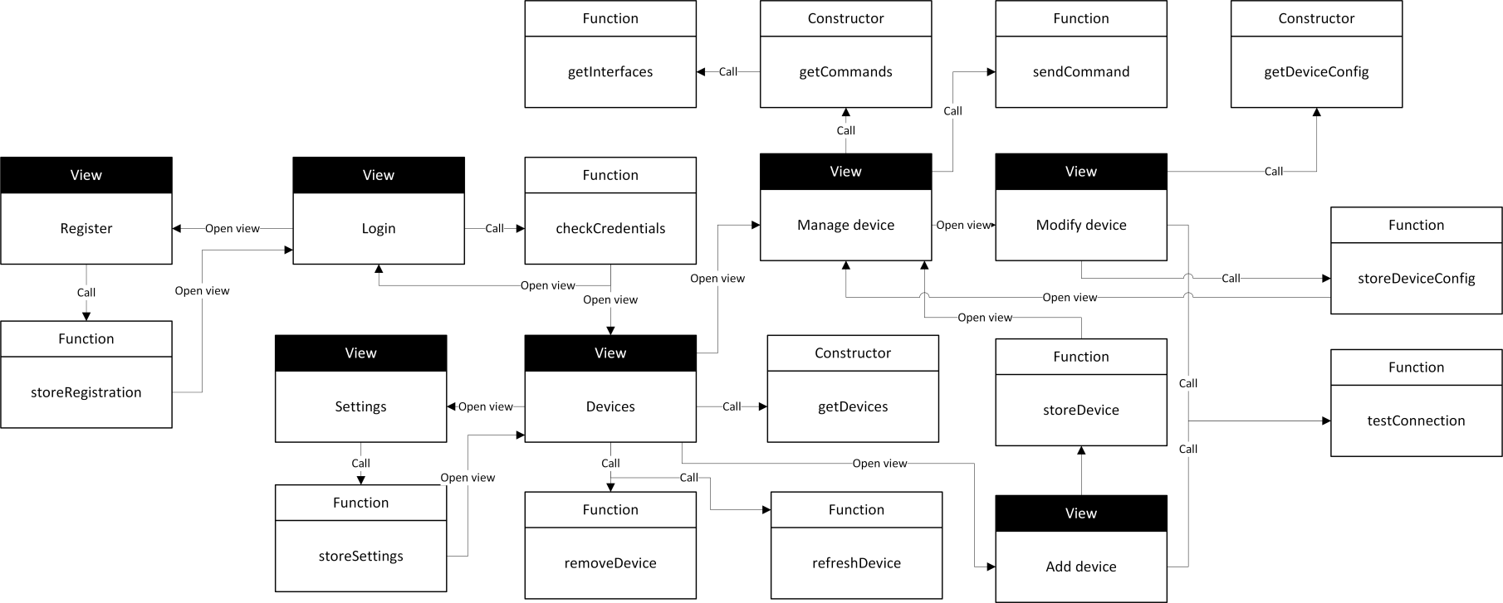
Application Architecture

Slide 20
Device Support
One XML file per supported device
XML contains
General device information
Supported communication protocols
Query commands to obtain port information
List of commands the device supports
Caching happens the first time a device is used

Slide 21
Demo
Show it

Slide 22
Development phase
Plan for the phase
Deadlines / milestones

Slide 23
Project Network Management System
Any Questions?

